Slide 1
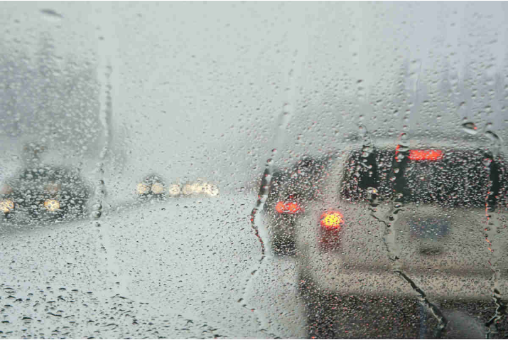
Capstone Project
Seattle Accident Data and Prediction Analysis

Slide 2
Seattle Accident Data – Analysis and Prediction
Objective is to Predict “Severity Code” based on human fatality, traffic delays, weather conditions, road, and visibility conditions. The data is available on IBM Capstone project in Coursera.
Depending on weather conditions the model will predict and alert the drivers and caution them reducing accidents and injuries.
Dataset Details
Data contains 194,673 rows and 38 columns.
Target variable is “Severity Code”. It is the dependent variable and contains numbers from 1 to 2 correspond to different levels of severity caused by accidents.
Data has null values, missing values, deleting unrelated columns and cleansed during data pre-processing.

Slide 3
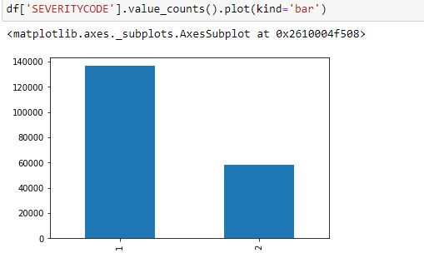
Seattle Accident Data – Analysis and Prediction
Count of Accidents by Severity code

Slide 4
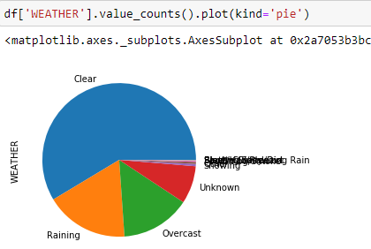
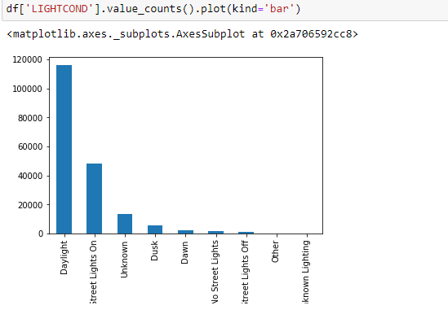
Seattle Accident Data – Analysis and Prediction
Count of Accidents by Weather conditions
Count of Accidents by Light conditions

Slide 5
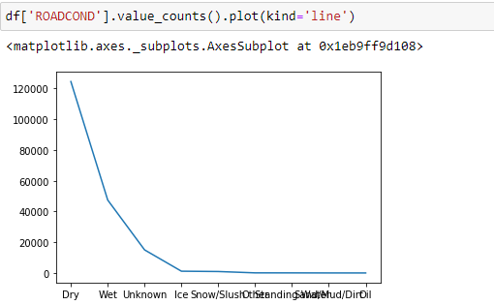
Seattle Accident Data – Analysis and Prediction
Count of Accidents by Road Conditions

Slide 6
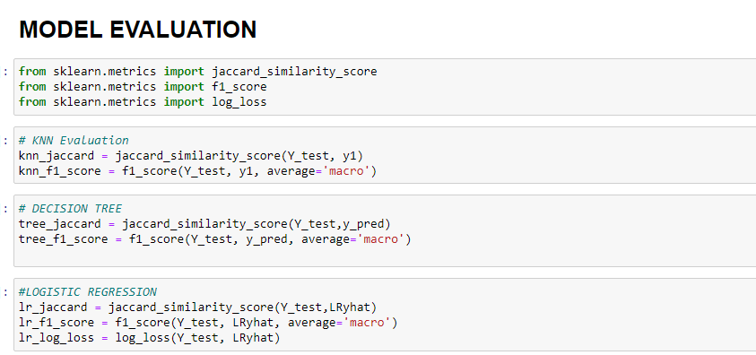
Seattle Accident Data – Analysis and Prediction
Models and Prediction
Below ML algorithms were applied to the data
KNN – K Nearest Neighbor
Decision Tree
Logistic Regression

Slide 7
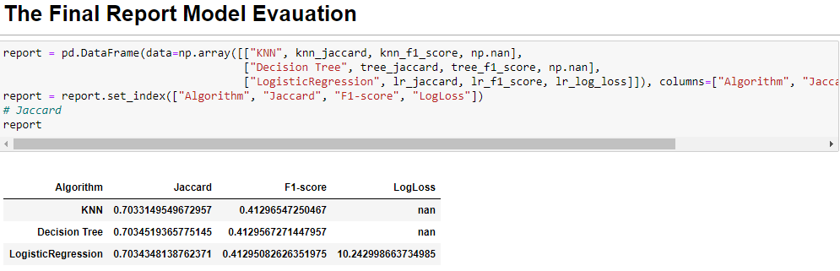
Seattle Accident Data – Analysis and Prediction
Based on the model Decision-Tree is best model to predict Car Accident.

